Slide 1


Slide 2





SP-2359 spike for new widgets in Taranta
SPO-1675
CREAM Team

Slide 3
Objectives
SPO-1675
O: To build validated mockups based on user interviews which will support future Taranta widgets/functionalities
  KR: Taranta developers can use the mockups to implement the actual widgets in a future
  KR: Widgets implementation can be better prioritized
SP-2359
spike for new widgets in Taranta

Slide 4
Participants:
Feature Owner Presenter
- J.Brajnik.
- M. Salitska
Widget researchers & designers - Taranta team.

Slide 5
Feature description
Proposed by the Feature Owner number of widgets (6) should provide the new functionality for SKAO users such as:
  widgets should be configurable, condition-related, compact.
Desirability of the new widgets - should be justified by the SKAO user`s needs (in this case, by users` feedback).
Usability principles - should be applied to the widgets` design.
Complications & challenges - should be taken into consideration.
Effort estimation (time, complexity) - should be calculated.
Purpose of the requirements is to capture stakeholders needs.
Slide / 5

Slide 6
Method:
Lean UX as an approach - based at the strategy: build-measure-learn.
Mockups` design was done in 2 stages -
  moderated research with the following user session (1:user), where basic design/ prototype was shown
  final session - usability testing of the widget mockup, based at the real data.
Key results - should be summarised & documented for sharing with the SKAO team.
Slide /

Slide 7
List of widgets (6):
1. Tabular info
2. Tabbed dashboard
3. Active dashboard
3a. Cycled dashboard
4. Active widget
5. Bar chart widget
6. Starburst diagram
M.Salitska/ A.Dubey A.Dubey/ M.Salitska M.Canzari / A.Dubey A.Dubey
H. Ribeiro
H. Ribeiro
A .Dubey / M.Canzari
Slide / 7

Slide 8
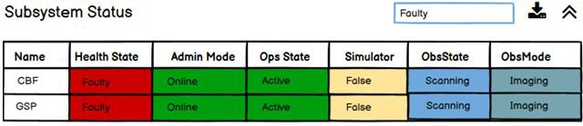
Widget 1 - Tabular info feature
Table usage
For overviewing general information like:
  showing various information about antenna, sub array or beams at single place. Tables are widely used in showing the set of attributes (health state, obs state, obsMode etc.) of a large number of devices.
To point when identifying crash data for operators and maintainers to track issues.
Tables can be configurable:
all dishes or receptors will be plotted on row and subcomponent, sub system
UI band receiver can be placed in column.
Applying filters will help to select required data.

Slide 9
Widget 1 - Tabular info feature
Widget desirability:
must-have.
But there is possibility/ desirability to have an automatic table with main device driver status parameters.

Slide 10
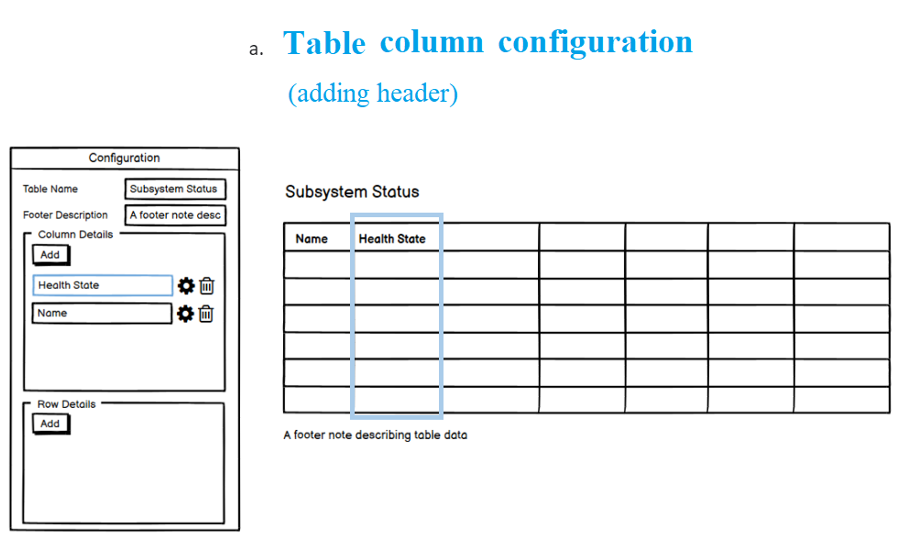
Widget 1 - Tabular info mockup

Slide 11
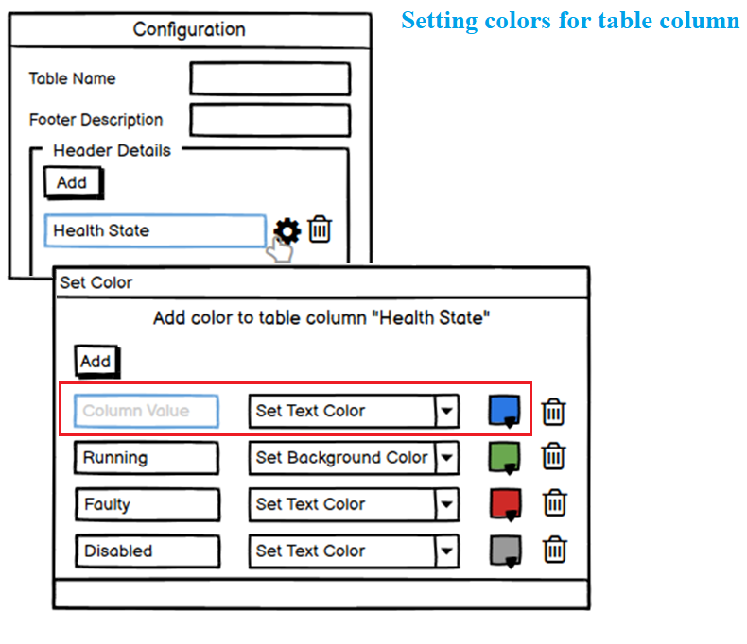
Widget 1 - Tabular info mockup

Slide 12
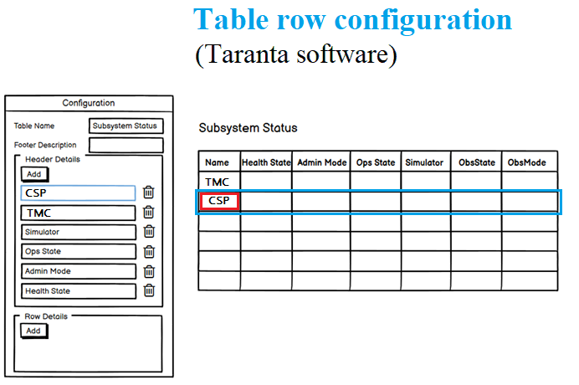
Widget 1 - Tabular info mockup

Slide 13
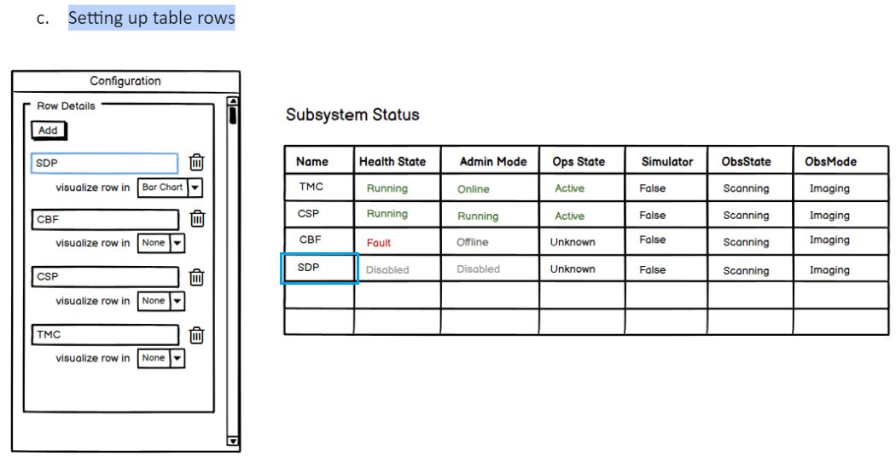
Widget 1 - Tabular info mockup

Slide 14
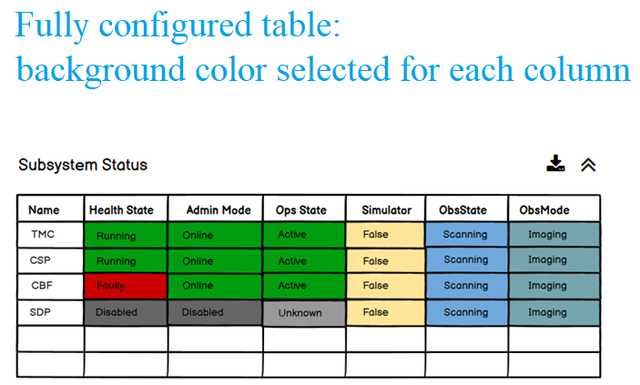
Widget 1 - Tabular info mockup

Slide 15
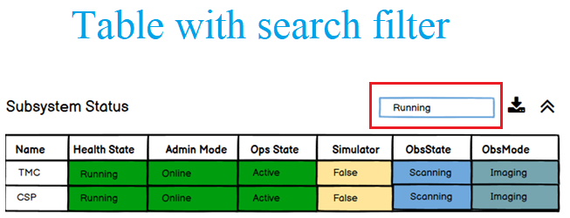
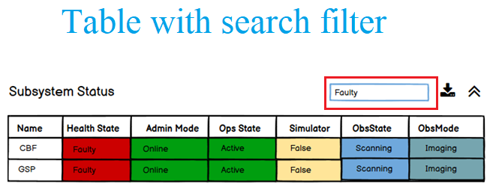
Widget 1 - Tabular info mockup

Slide 16
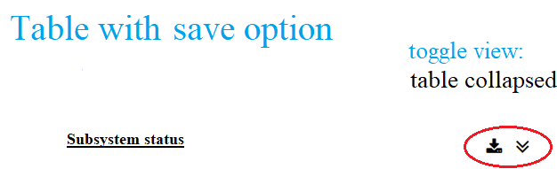
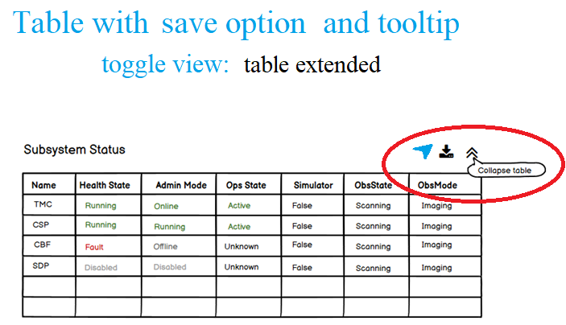
Widget 1 - Tabular info mockup

Slide 17
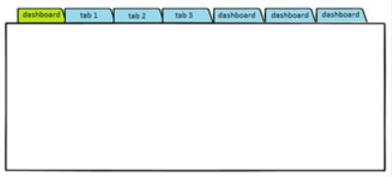
Widget 2 - Tabbed dashboard feature
Dashboard can be considered as a visual display of all our data, set or collection of the various widgets that can give overview, some specific data, metrics or reports.
Also it can be considered as a separate widget, standing alone at the screen, next to another content.
Tabbed dashboard - where tabs serve as link to other pages:
  this way tabs organize dashboard widgets into logical groupings (for example: charts, graphs or tables).
Main users - SKAO engineers, but also can be used by other members of SKAO teams, such as: software developers, operators.
Widget desirability: must-have widget.

Slide 18
Widget 2 - Tabbed dashboard feature
Widget can be configured - with such properties as:
number of tabs
tabs` names.

Slide 19
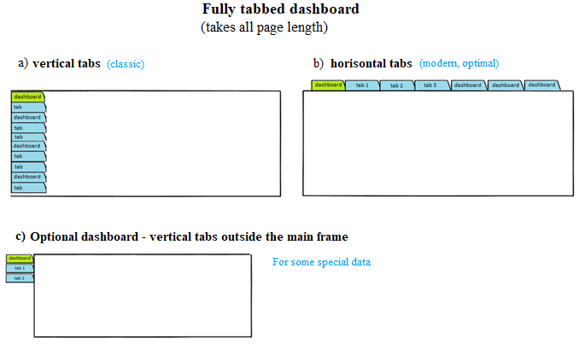
Widget 2 - Tabbed dashboard mockup

Slide 20
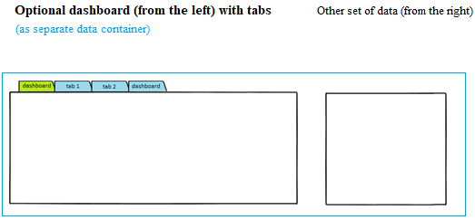
Widget 2 - Tabbed dashboard mockup

Slide 21
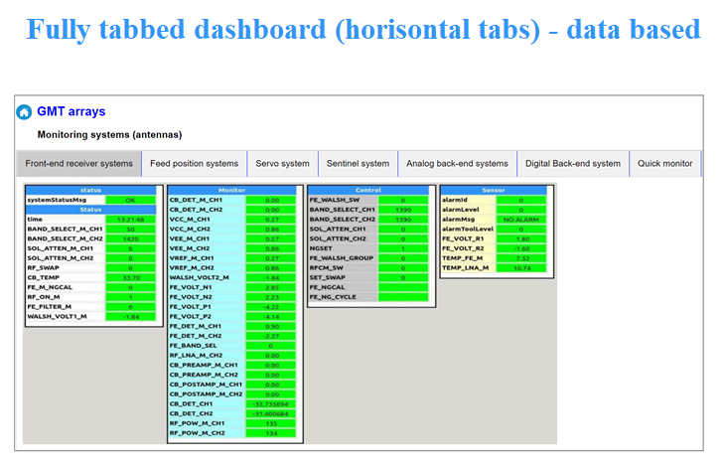
Widget 2 - Tabbed dashboard mockup

Slide 22
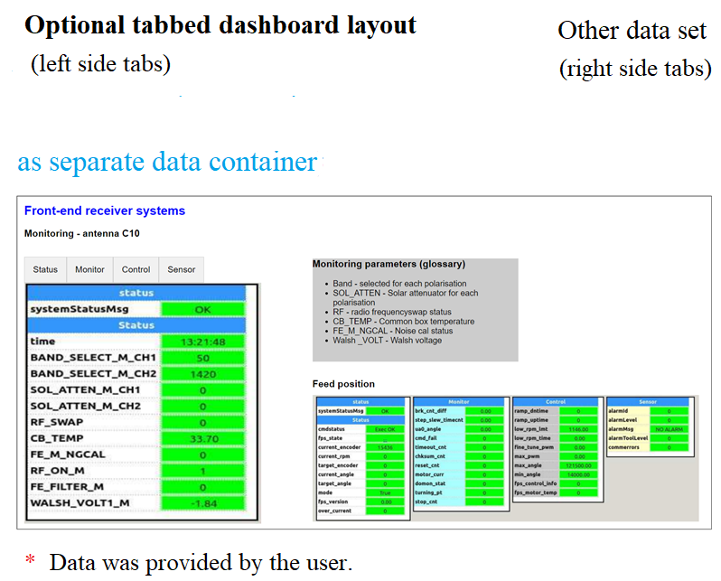
Widget 2 - Tabbed dashboard mockup

Slide 23
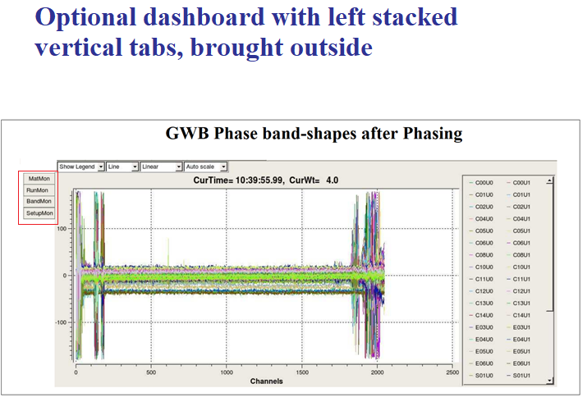
Widget 2 - Tabbed dashboard mockup

Slide 24
Widget 3 - Active dashboard
Use case:
  tabbed dashboard, where user can disable a single tab and leave as
  visible other tabs.
Such dashboard is called an active dashboard and, as a feature, will enable user to configure tabs.
Configuring tabs will depend on some condition or event.
Can be limited by setting specific time interval.

Slide 25
Widget 3a - Cyclic dashboard feature
Use case:
The user can link dashboards in a loop so that when run, the system shows each dashboard for a given time and then switches to the next tab/dashboard. Or the user can manually switch to other tabs.
This is how cyclic dashboard can be created.
Running dashboard automatically
The user can link dashboards in a loop:
the system will show each dashboard for a given period of time ->
and switch to the next tab/ dashboard.
Running dashboard manually
User can manually switch to other tab.

Slide 26
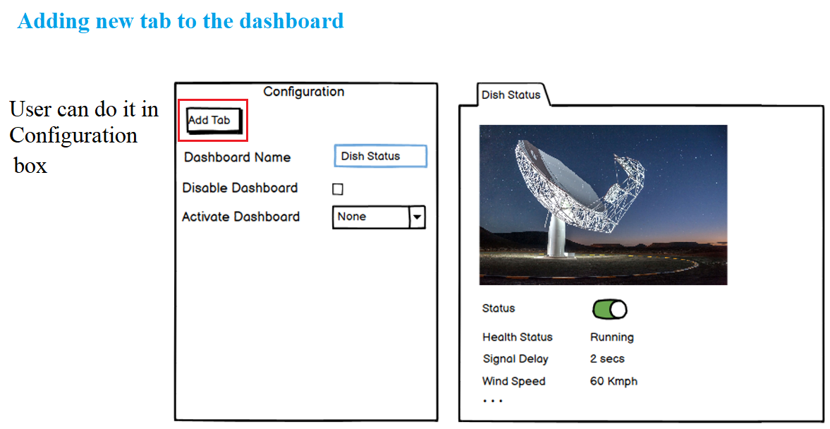
Widget 3a - Active & Cyclic dashboard feature

Slide 27
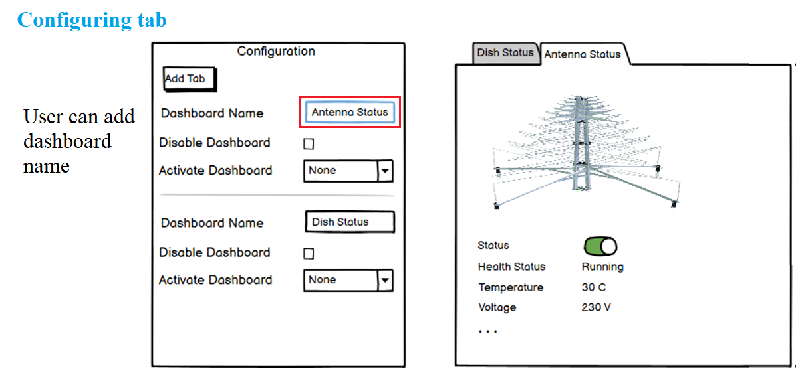
Widget 3a - Active & Cyclic dashboard feature

Slide 28
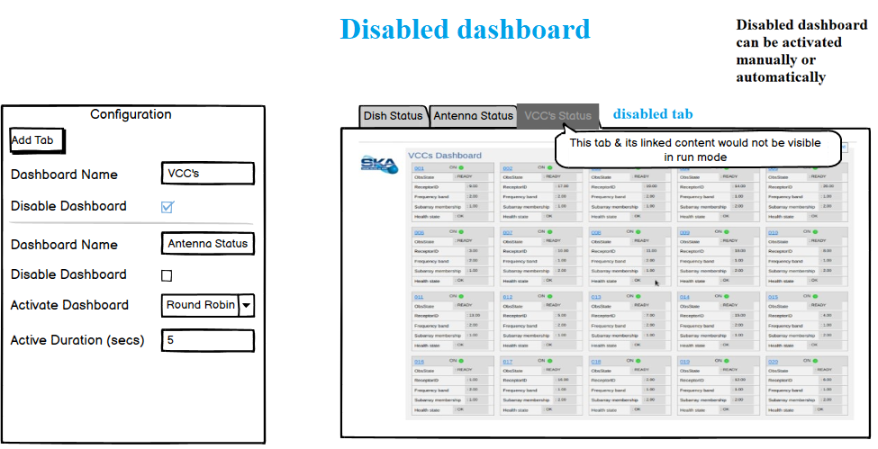
Widget 3a - Active & Cyclic dashboard feature

Slide 29
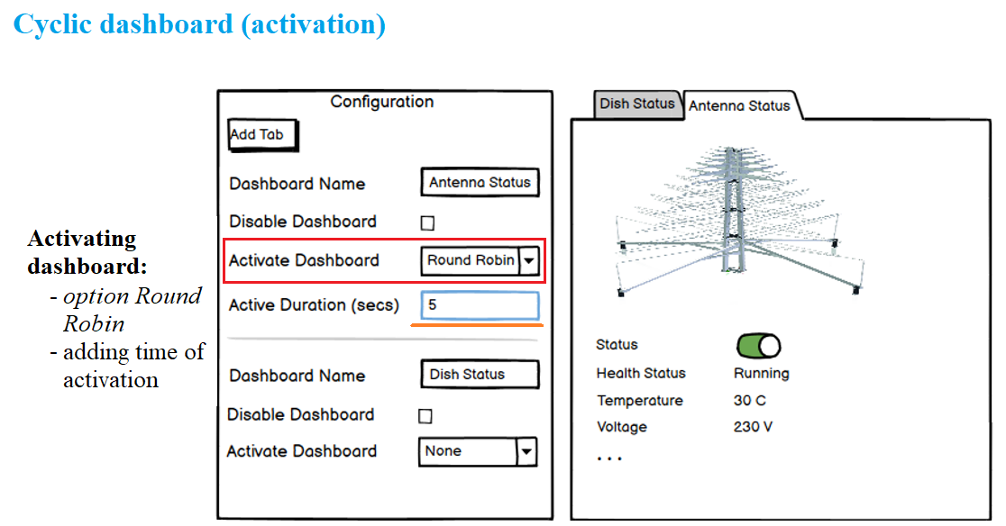
Widget 3a - Active & Cyclic dashboard feature

Slide 30
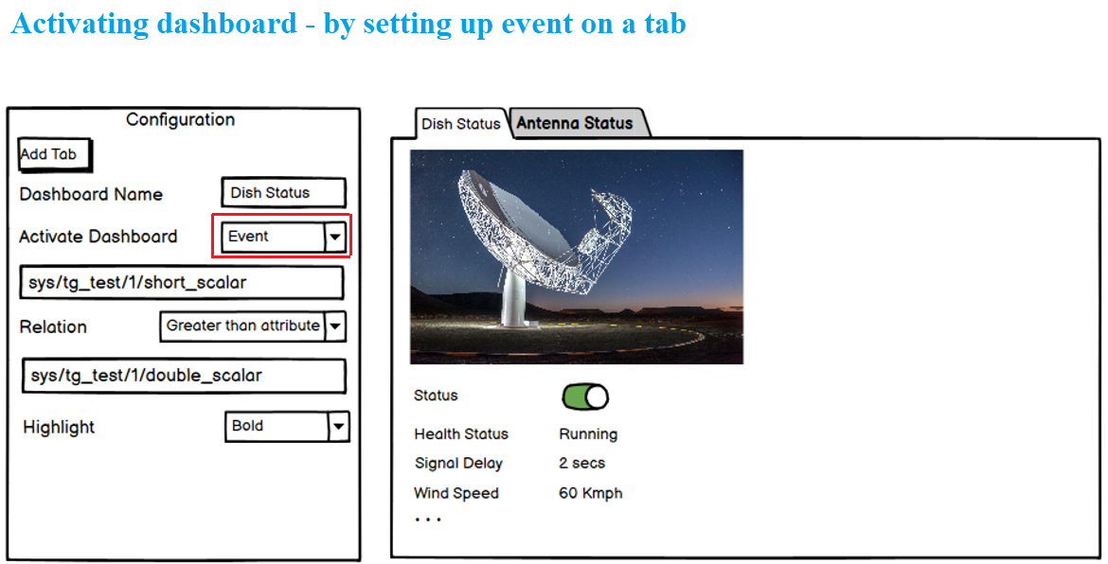
Widget 3a - Active & Cyclic dashboard feature

Slide 31
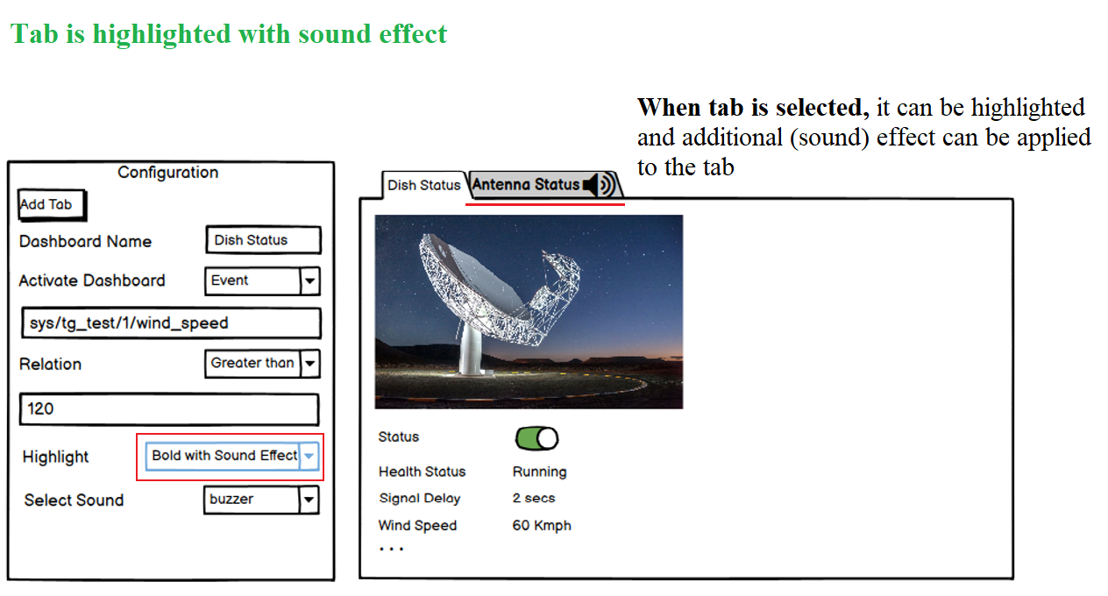
Widget 3a - Active & Cyclic dashboard feature

Slide 32
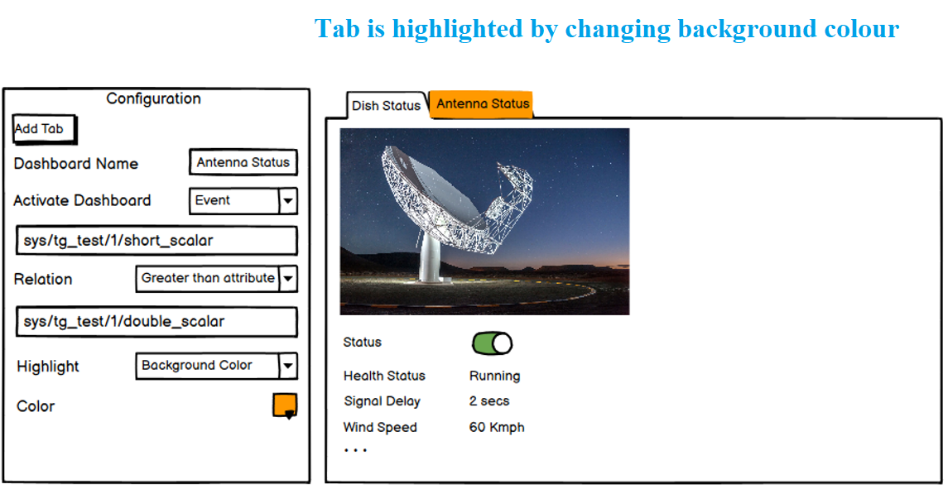
Widget 3a - Active & Cyclic dashboard feature

Slide 33
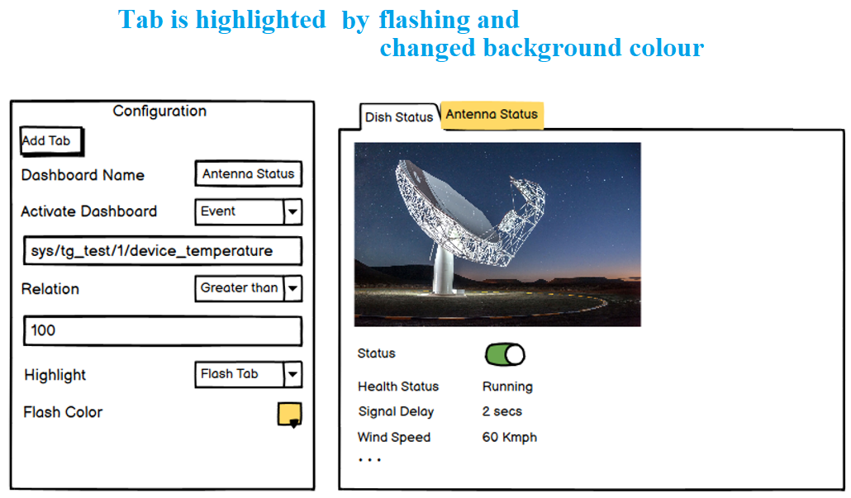
Widget 3a - Active & Cyclic dashboard feature

Slide 34
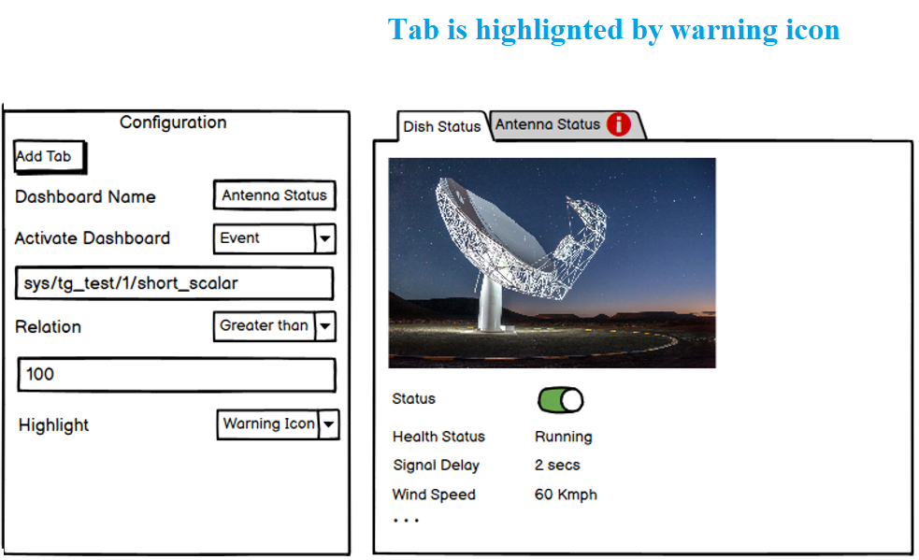
Widget 3a - Active & Cyclic dashboard feature

Slide 35
Widget 4 - Active widget feature - Toggle state
Active widget or collapsible widget allows the user to switch between collapsed view and expanded by clicking on the widget title.
It is a must-have widget that can be used by all SKA operators, dashboard engineers and service technicians.
Widget`s usability is based at its ability to save space and better focus user`s attention on a particular widget function.
  Once widget expanded, its content can be updated dynamically & displayed for viewing.
  The collapsed/expanded state can be saved into local storage or browser cookies.

Slide 36
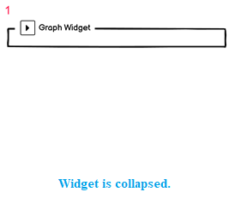
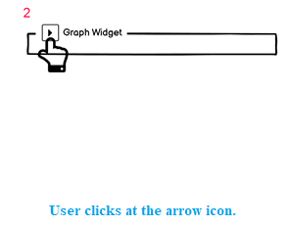
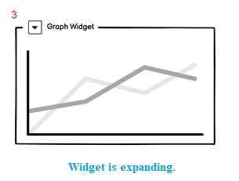
Widget 4 - Active widget feature - Toggle state

Slide 37
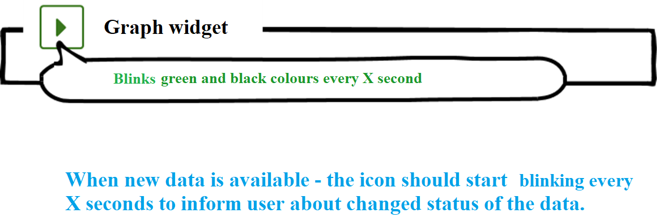
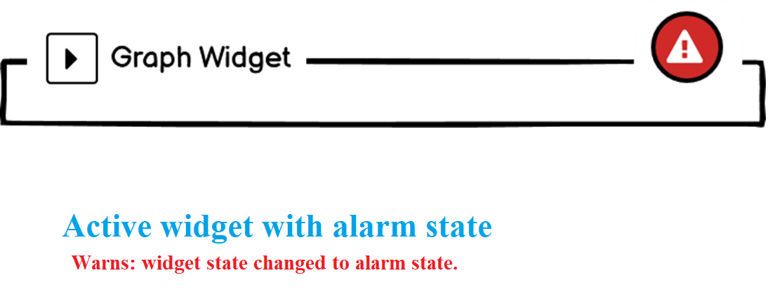
Widget 4 - Active widget mockup - Toggle state

Slide 38
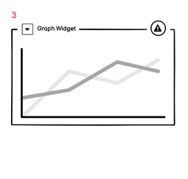
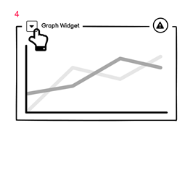
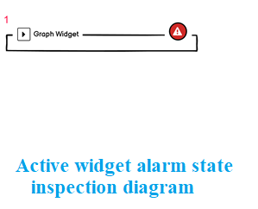
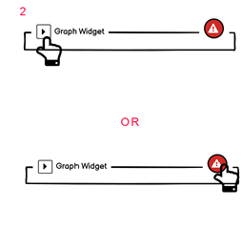
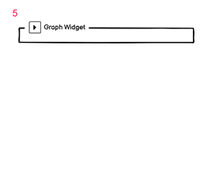
Widget 4 - Active widget - Alarm state

Slide 39
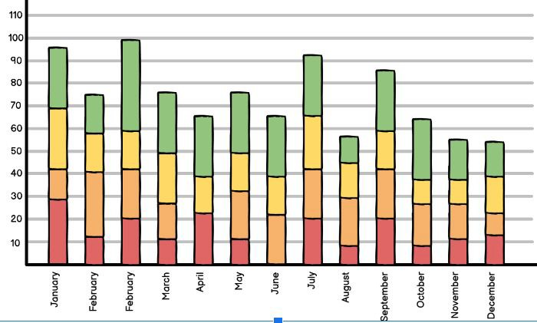
Widget 5 - Bar chart widget feature
* A
chart or graph that presents categorical data as rectangular bars
with a height or length proportional to the presented values.
Bar graph structure - does comparison among discrete categories. One axis of the chart - shows the specific categories being compared. Other axis - represents a measured value.
Some bar graphs present bars clustered in groups of more than one, showing the values of more than one measured variable.

Slide 40
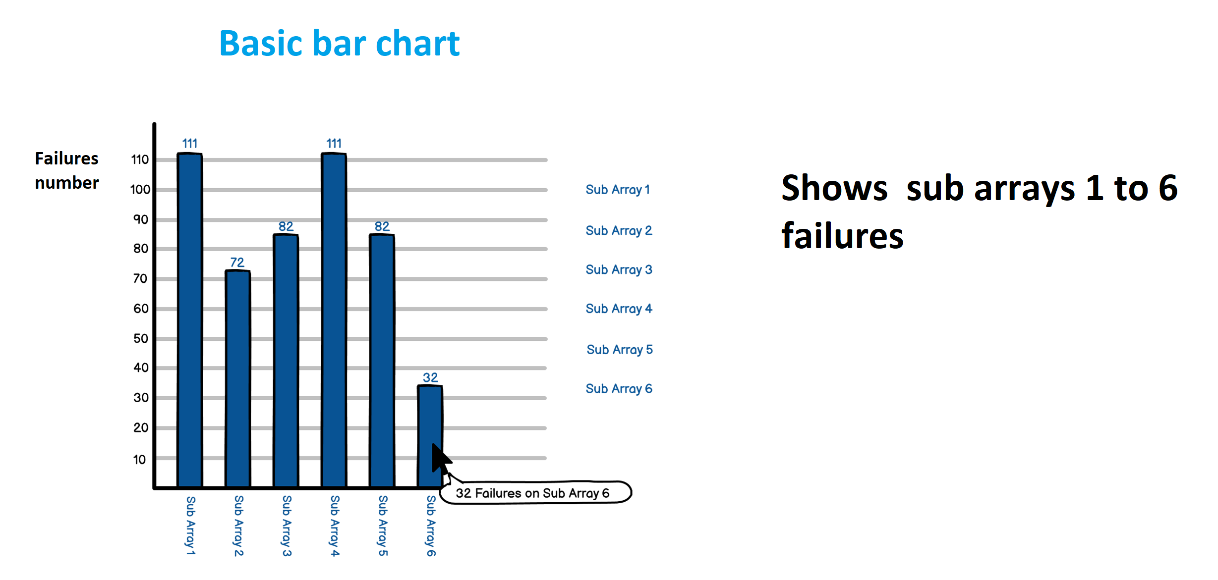
Widget 5 - Bar chart widget mockup

Slide 41
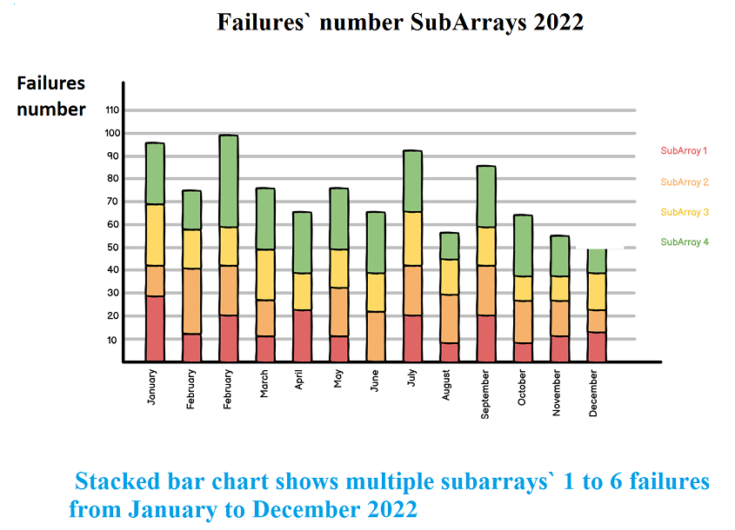
Widget 5 - Bar chart widget mockup

Slide 42
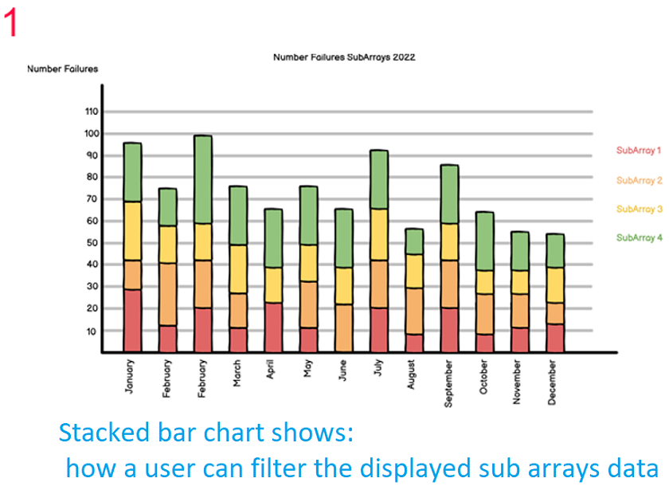
Widget 5 - Bar chart widget mockup

Slide 43
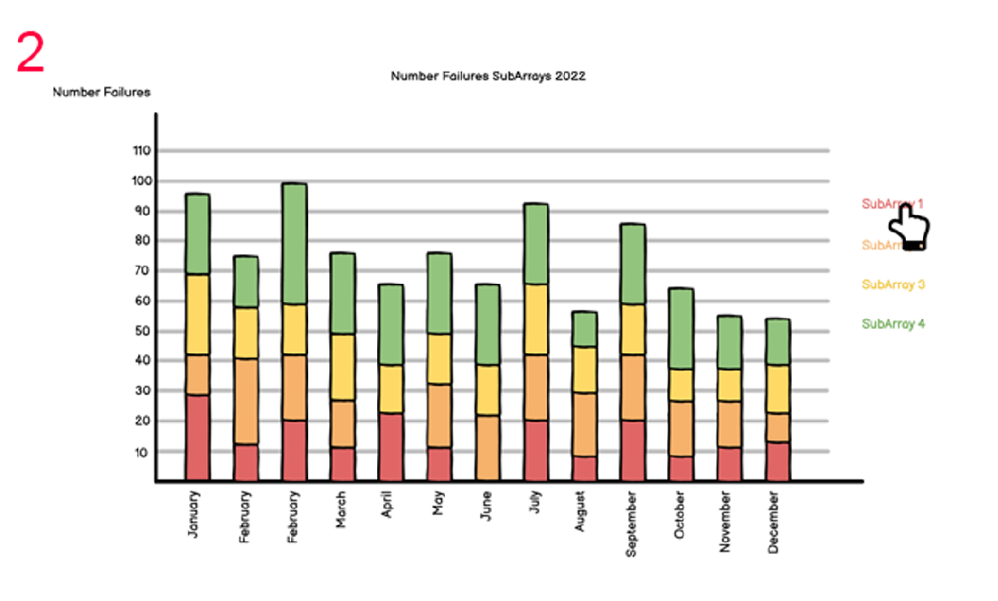
Widget 5 - Bar chart widget mockup

Slide 44
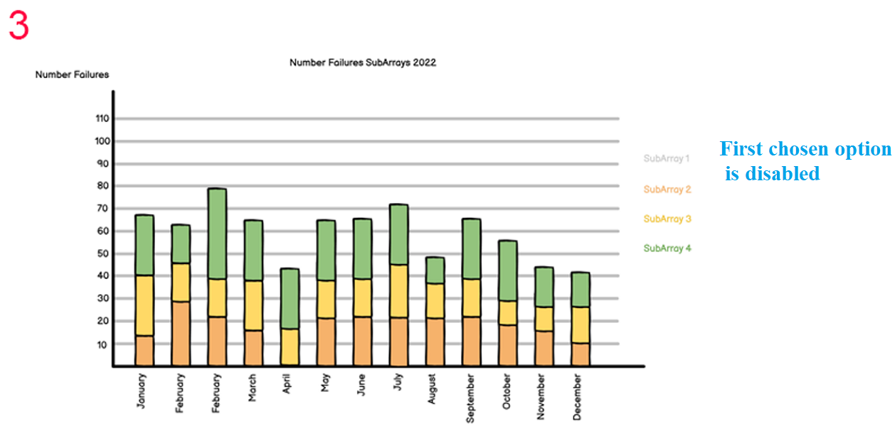
Widget 5 - Bar chart widget mockup

Slide 45
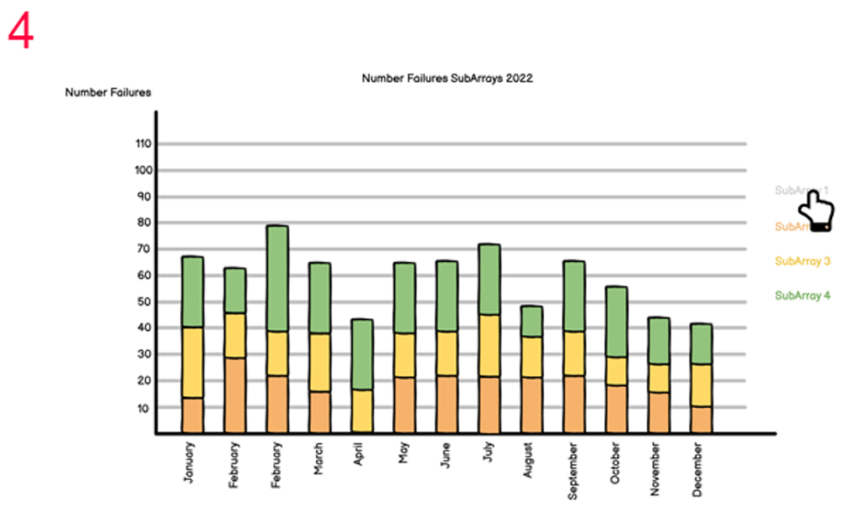
Widget 5 - Bar chart widget mockup

Slide 46
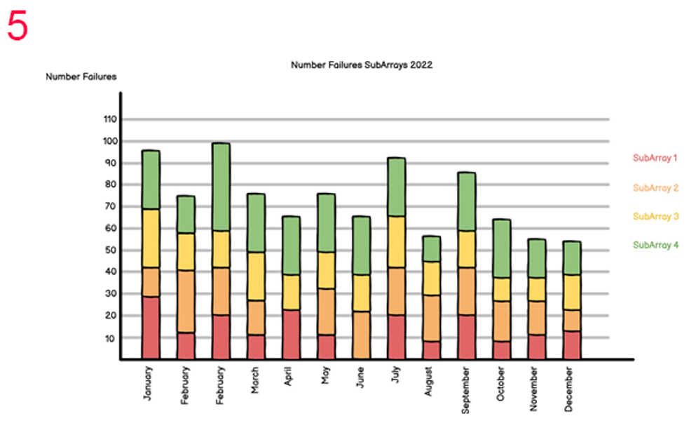
Widget 5 - Bar chart widget mockup

Slide 47
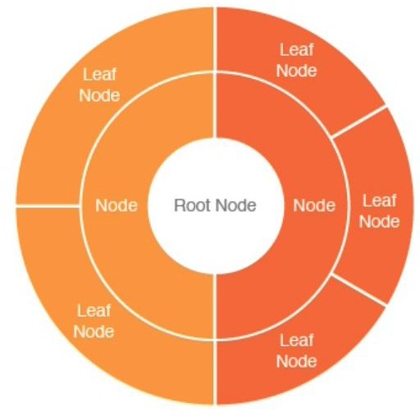
Widget 6 - Starburst diagram feature
Such diagram is common in data visualization as it is:
parent-child-based structure
& can easily represent hierarchical data.
The circle in the center (or inner circle) represents the root node. Outer concentric circles – are child nodes.
Innermost circle is a top of the hierarchy.
The hierarchy moving outward from the center.
Each level of the hierarchy is represented by one ring/ circle.

Slide 48
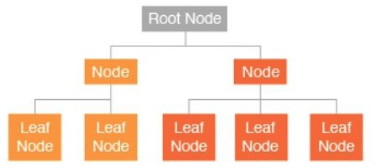
Widget 6 - Starburst diagram feature
SKA usage context
Mainly: for telescope operators. Can be used also:
for Science operations
engineering operations
maintainers.
Examples of the use:
health status view
investigating failures.
Widget desirability: want-have.

Slide 49
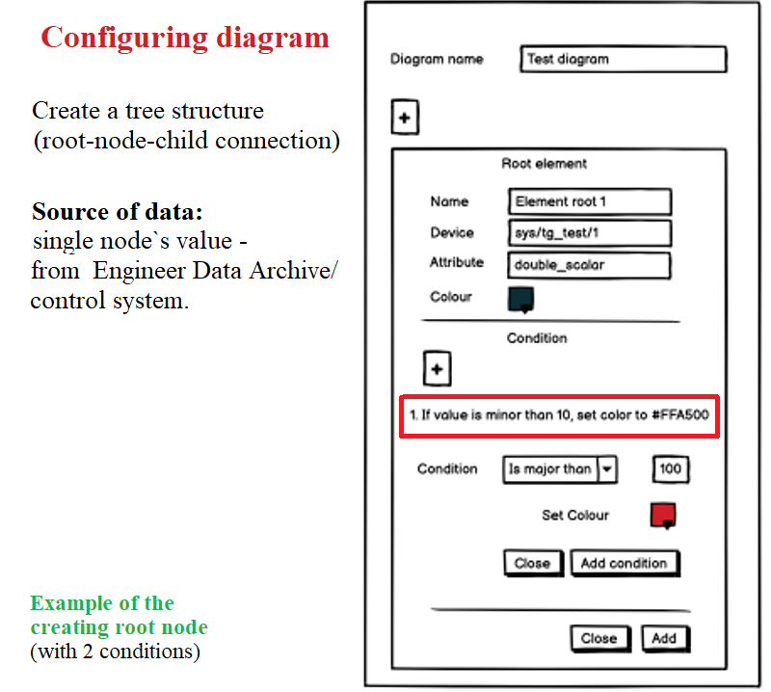
Widget 6 - Starburst diagram mockup

Slide 50
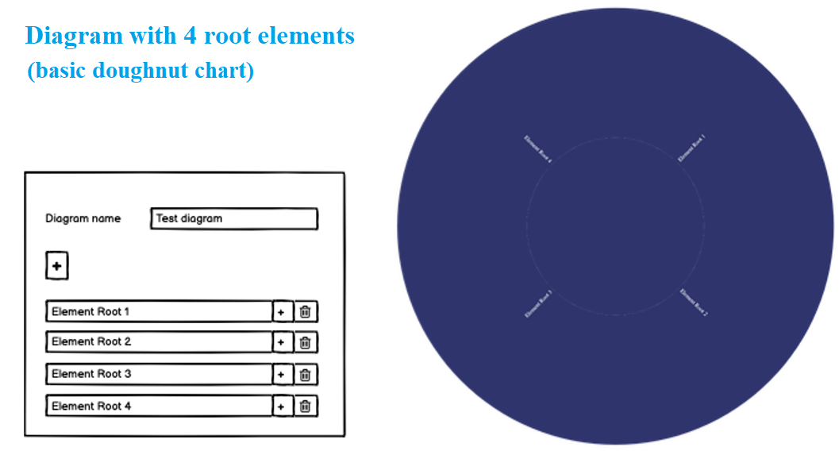
Widget 6 - Starburst diagram mockup

Slide 51
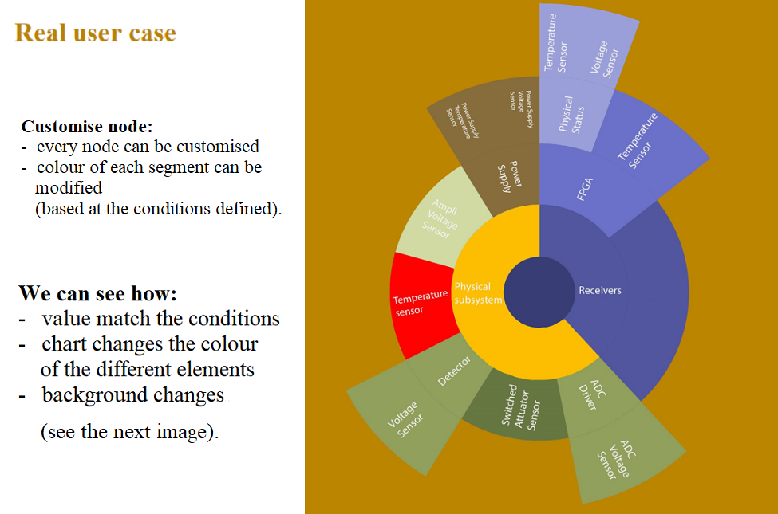
Widget 6 - Starburst diagram mockup

Slide 52
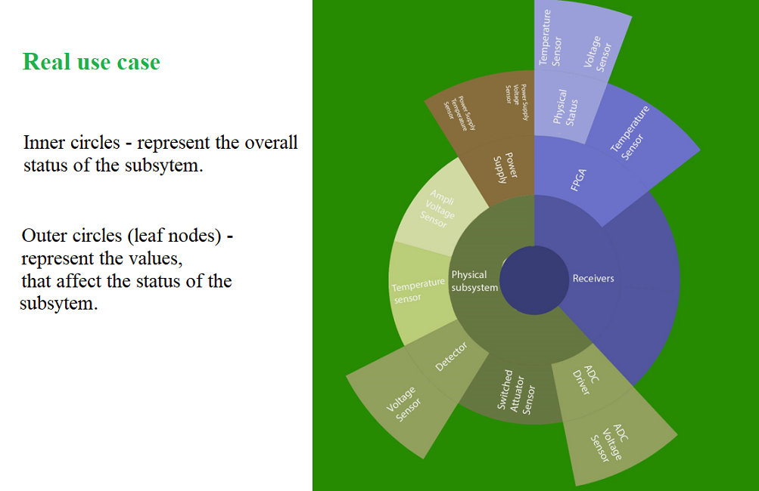
Widget 6 - Starburst diagram mockup

Slide 53
Time estimation
Team has done calculation in a terms of creating widgets. Estimation data is available.
Tabular info:
Approximately 4.25 FP Empty table widget: 3 SP Setup of Add Header: 5 SP
Setup of Add Header > set color: 5 SP Show on header on run: 5 SP
Table row setup: 5 SP Download table as CSV: 5 SP Collapse Table: 3 SP
Action column(for external Url setup): 3 SP.

Slide 54
Time estimation
Tabbed dasboard:
Is a summary of the efforts, given to build an active dashboard (depends on complexity of data to be loaded).
Approximately: 3 FP.
Active dashboard
Closely related to the tabbed dashboard because it configuration is done when creating of tabbed dashboard = 3 FP (excluding the effort of the tabbed dashboard).
Active widget
As a single widget feature = 0.5 FP.
As a library to apply to all widgets at once =5 FP.

Slide 55
Time estimation
Bar chart
As there was no special requests to use on Taranta (Plotly) = 2 FP.
Starburst diagram
The correct estimation of the widget requires a deeper understanding. In general, we can split development in 2 parts:
If Plotly library permits to:
  render different set of data in a single diagram
  to customize colors and add colors based on condition -> we will create only generic plot, using existing Plotly library = 1 FP
Otherwise (if new library will be used) = 2-3 FP
Configuration. 3-4 FP

Slide 56
Appendix
Google Drive (list of documents)
SP-2359 - Software Engineering - Google Drive
CT-673 Create a structure for the document to summarise results of SP-2359.pdf
SP-2359 spike for new widgets in Taranta (no animation).pptx
Relevant for widgets` design documents, created by the team members, are at the same folder.

Slide 57
End of presentation
Thanks for attention!

