Slide 1
WebJive for CIPA
By: Stefan Nestorovski

Slide 2

The Goal of this Investigation
Get familiar with WebJive:
  - Investigate the WebJive development platform
  - Develop a WebJive interface for a test TANGO device server
  Demonstrate to the team about WebJive development flow and example GUIs/device servers
  What we were looking for:
  Scalable
  Customizable
  Easy-to-use
  Visually pleasing

Slide 3
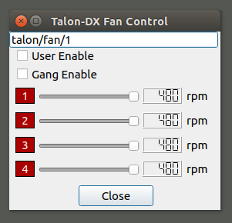
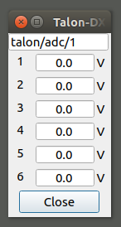
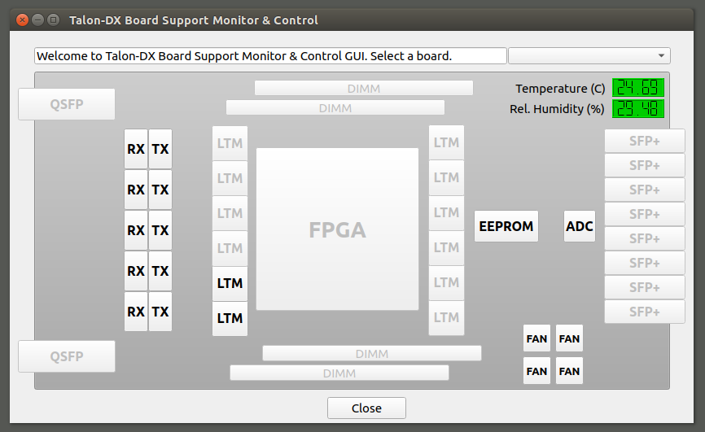
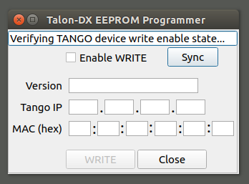
The Goal of this Investigation
Previously, Talon-DX Monitor package used Python developed GUI’s:
  Highly customizable, but difficult to use and create

Slide 4
What is WebJive
A web-based program that allows users to create GUIs (called dashboards) using widgets, which may include charts, numerical indicators or dials that interface to a Tango device back-end database.
With this device explorer built on TangoGQL, you can:
View a list of all Tango devices
View and modify device properties
View and modify device attributes
View and execute device commands
Create web interfaces for interacting with Tango devices

Slide 5
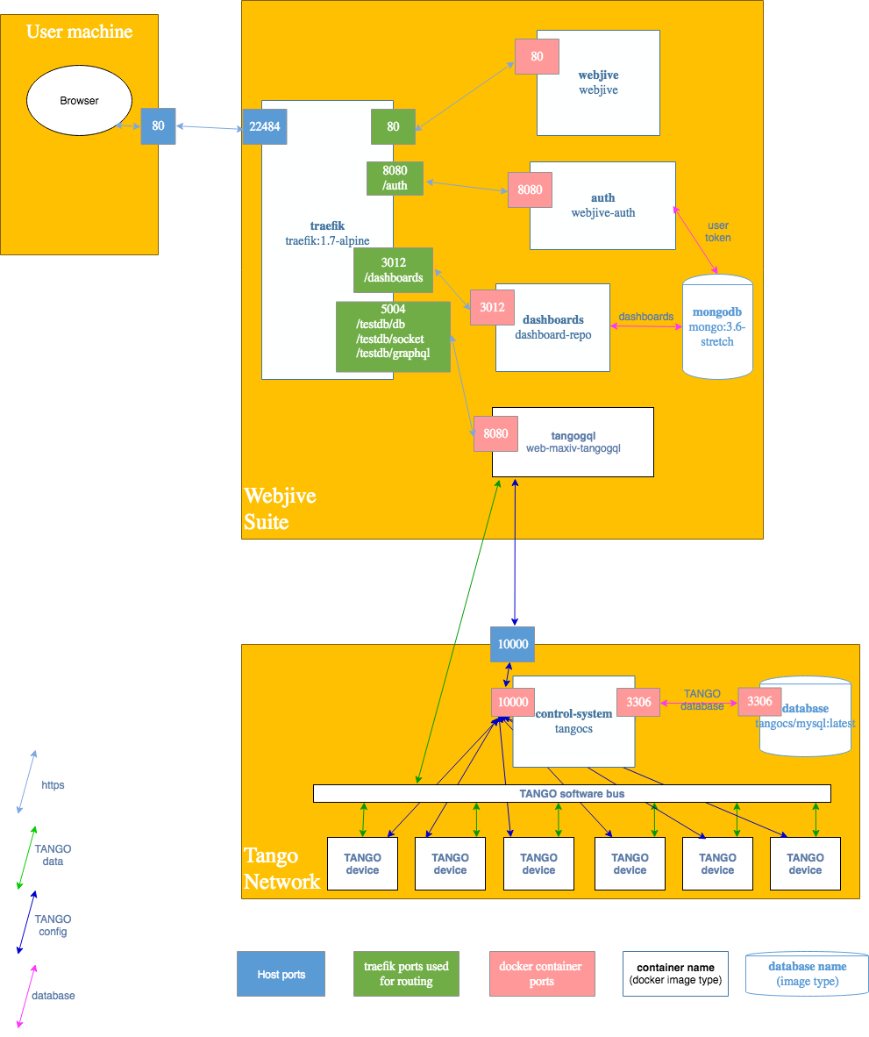
The Whole System
3 parts:
Tango Network
WebJive Suite
User’s Machine

Slide 6
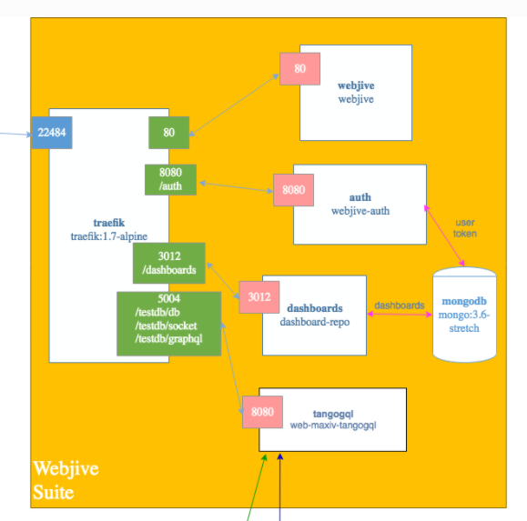
The WebJive Suite
- Each white box represents a separate docker image running
- The whole suite (orange) is run using either docker-compose or in kubernetes or docker-cluster

Slide 7
Setting up WebJive Locally
Easiest method for setting up locally is using this repo:
https://gitlab.com/MaxIV/webjive-develop
Steps for setup:
Clone repo and run WebJive suite
Point WebJive to existing Tango DB
Rerun suite and login through browser
* More in-depth steps can be found here

Slide 8
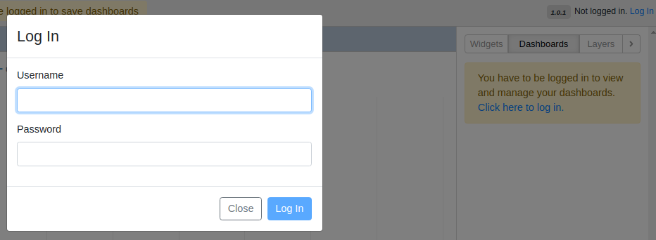
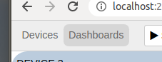
Setting up WebJive
- Navigate to localhost:22484/testdb/
- In top right, click login and sign-in using the credentials:
Username: user1
Password: abc123
In top left, can switch between “devices” and “dashboards” tabs:
Devices - Similar to the Jive view of listed devices
Dashboard - Where you create and run a dashboard monitor

Slide 9
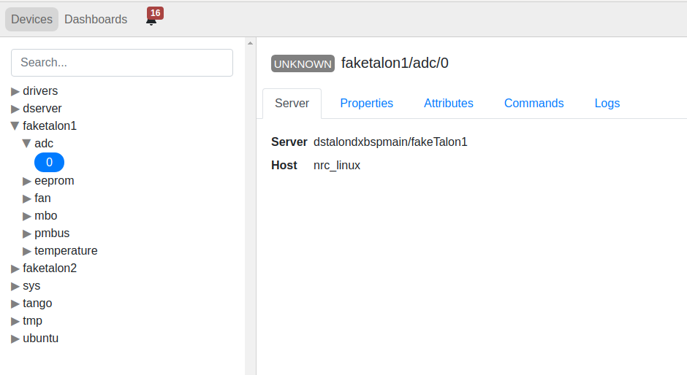
Using WebJive – Devices Tab

Slide 10
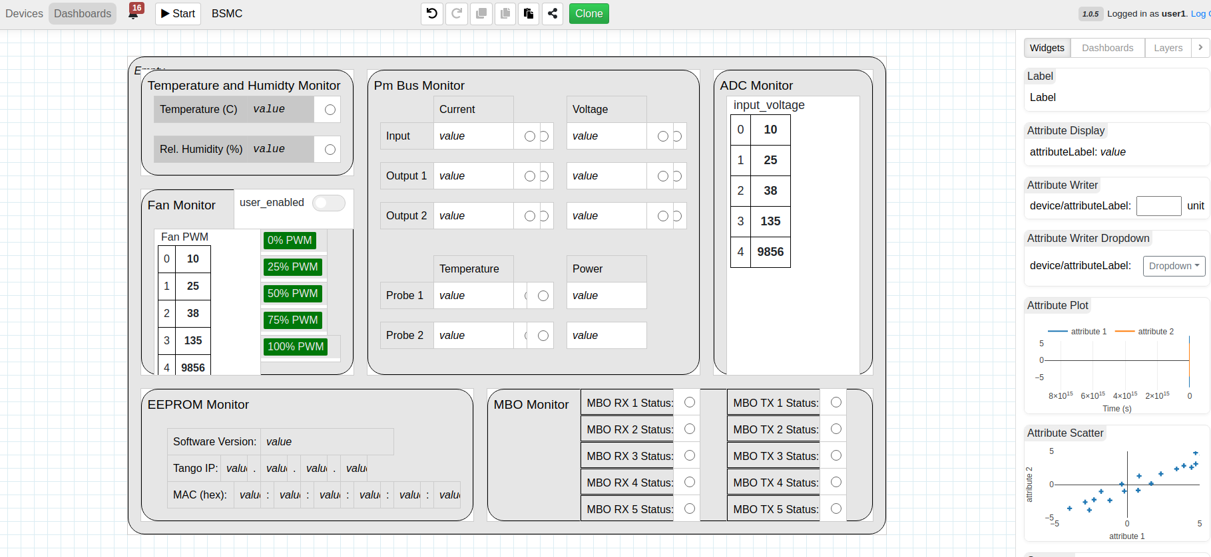
Using WebJive – Dashboards Tab

Slide 11
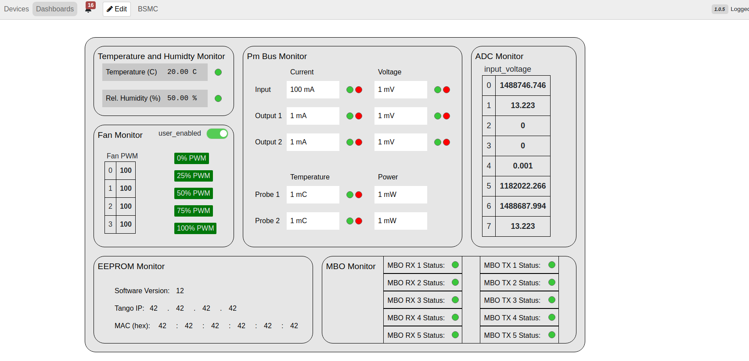
Using WebJive – Running a Dashboard

Slide 12
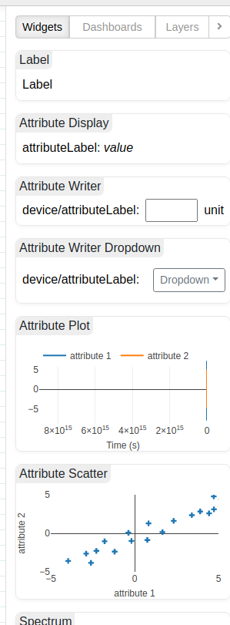
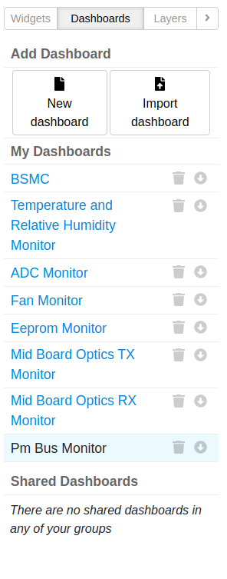
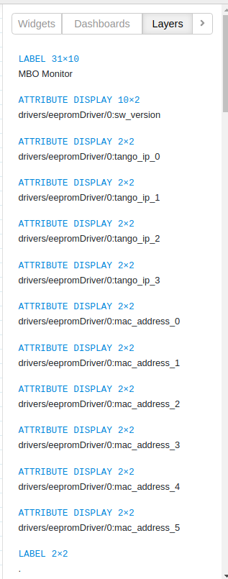
Using WebJive – Dashboards Tab
Click and drag in widgets
Change/create/share dashboards
Adjust widget positions
  Future work to group widgets into 1 layer

Slide 13
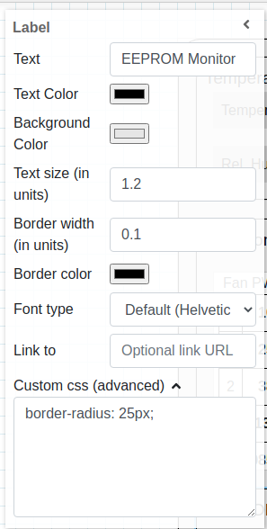
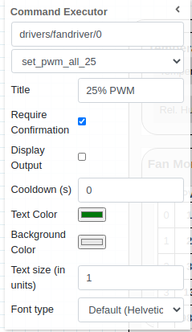
Using WebJive - Widgets
Everything added to the dashboard is a widget
Each one has a list of configurable properties about the display content and how it looks
Most popular:
  Label
  Attribute Display
  Attribute Writer
  Command Executer
  LED status
* Detailed list of all available widgets found here

Slide 14
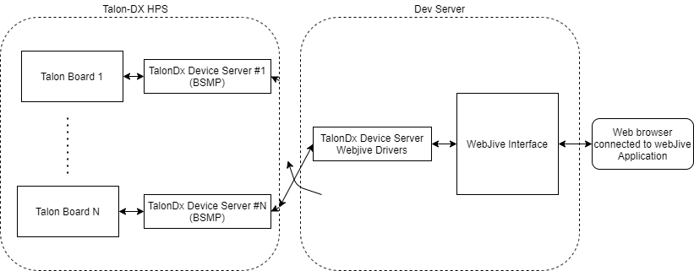
Using WebJive - Drivers

Slide 15
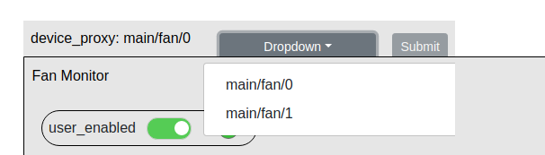
Using WebJive - Drivers
Pros:
Allows code that is solely used for WebJive to be abstracted out of the code from the main device servers
Only a single dashboard needs to be created to support all talon-dx boards
Cons:
Additional work needed to implement
Responses back and forth between dashboard and devices slower

Slide 16
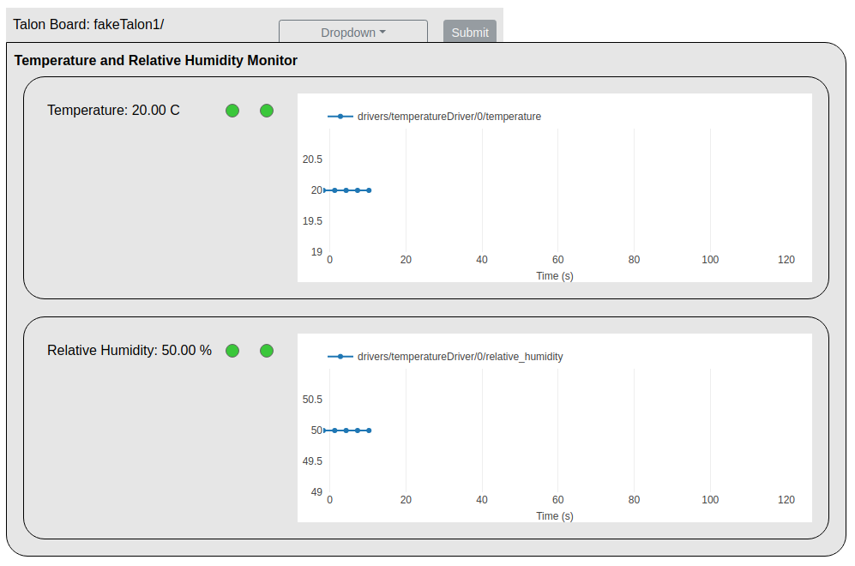
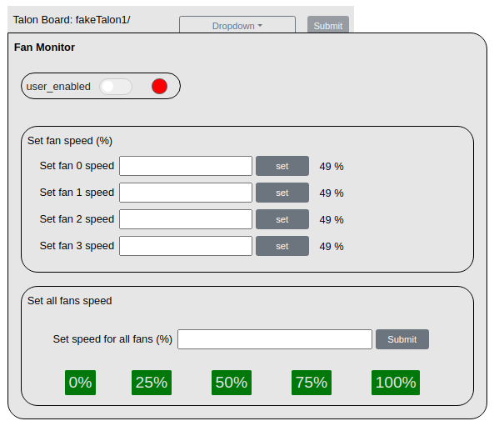
Using WebJive - Examples

Slide 17
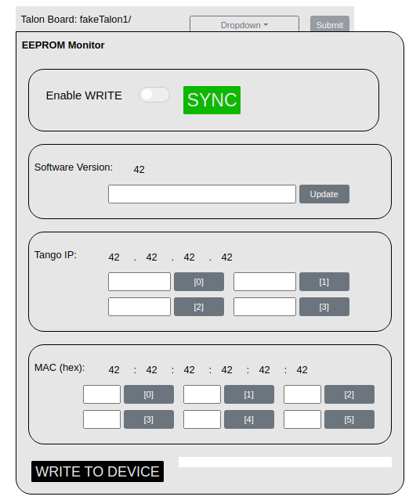
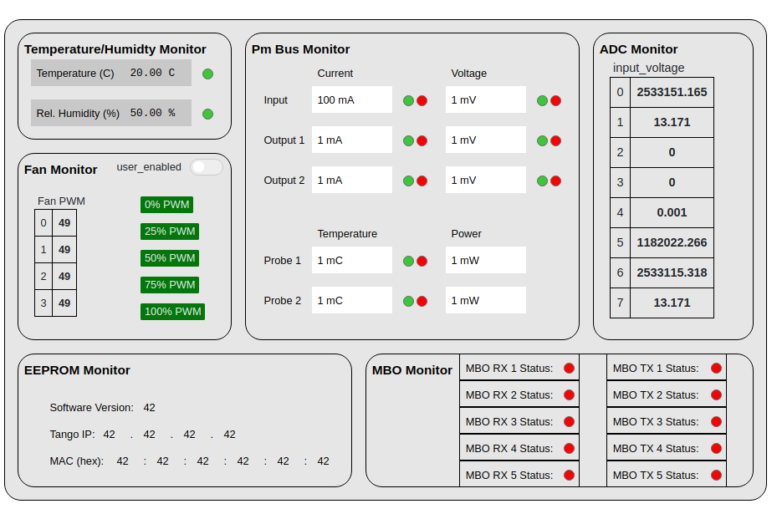
Using WebJive - Examples

Slide 18
WebJive - Summary
  What we were looking for:
  Scalable: Parameterization seems to have gained higher priority as a result of this investigation, leading to more scalable solutions
  Customizable: Missing interface logic, can be overcome using a WebJive driver system
  Easy-to-use: Dragging and dropping widgets in – couldn’t be easier
  Visually Pleasing: pretty, but sizing things is a little clunky

