Slide 1
PI#8 – Demo, Features SPO-831 & SP-476: Updating Board Support Monitor Package (BSMP) and implementing to webJive
PI8
SP-476: TALON-DX Board Support Master GUI - packaging and deployment - Part 1
SPO-831: Incorporate Webjive in TALON development environment
NRC/MDA
19 Nov 2020

Slide 2
Objectives
SPO-476
- Demonstrated understanding of how to provide graphical user interface to TANGO device servers within the WebJIVE platform
- Talon-DX Board Support Monitor & Control GUI functional within the WebJIVE platform
SP-831
- Learn how to use Webjive to develop GUIs that communicate with software running on TALON-DX Board HPS.
  - TALON Board GUI based on Webjive framework that displays the key monitoring points for the devices located on the board.

Slide 3
What was achieved
    BSMP device servers all combined into one singular package:
        Temperature/humidity, ADC, Fan, Pm Bus, EEPROM, Mid Board Optics
    Dashboards to display each device server created in the webJive
    Feedback given to webJive team on how to improve our use

Slide 4
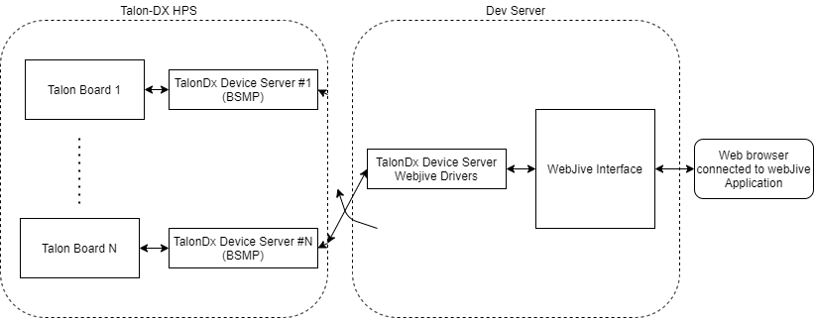
WebJive to Talon Board Connection

Slide 5
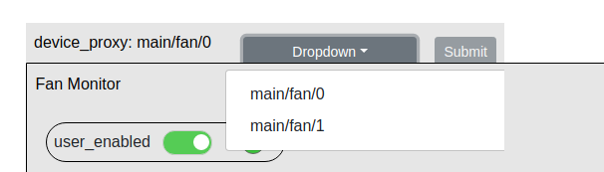
WebJive Drivers
Pros:
Allows code that is solely used for webjive to be abstracted out of the code from the main device servers
Only a single dashboard needs to be created to support all talon-dx boards
Cons:
Extra work to implement
Responses back and forth between dashboard and devices slower

