Slide 1
PI8 Demo
SP-1151: Firmware Release Flow
CIPA Team
19 November 2020

Slide 2
Motivation
SPO-756: To create a coherent firmware release flow that allows traceability from bitstreams produced through the CI flow to exact firmware code used to produce the binary.
CIPA team uses continuous integration (CI) in FPGA development
  An FPGA build (bitstream) reflects current state of several repositories.
CIPA software group is the consumer of FPGA binaries.
  Writing software against “moving target” firmware makes it difficult to:
    track issues through the software/firmware/hardware layers.
    reproduce a test setup.
    audit the code that was deployed on the board.
Need a defined hand-off point between firmware and software.

Slide 3
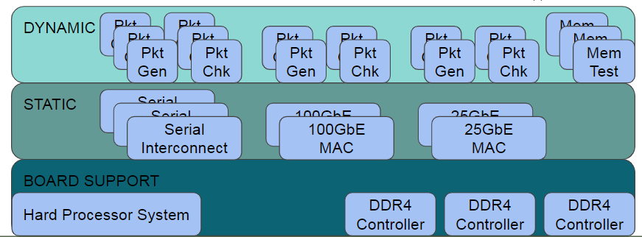
FPGA Firmware Structure
From W. Kamp, FPGA Firmware Structure.
  Dynamic layer defines the application – release from here.
  Static layer defines physical interfaces.
  Board support layer manages basic Talon-DX functionality.
All layers and all their dependencies must be tagged for release.
  Use semantic versioning as per SKA guidelines.

Slide 4
Solution
Tag every repo required to build FPGA binary with the same tag.
  Avoid overhead of individually tagging each dependency.
  Avoid breaking the CI concept on the firmware side.
  Have a level of traceability when releasing to software.
Use the Gitlab Releases feature to release binary to software.
  Integrate this flow into our development and CI process.
  Create a new release upon successful build.
  Provide a release note to describe what has changed.

Slide 5

Command Line Tool
General usage:
A release note template can be generated automatically:
Version is determined automatically by choice of major/minor/ patch, most recent release, and semantic versioning rules.

Slide 6


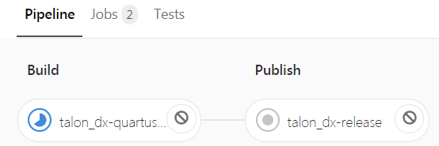
Gitlab CI Flow
Regular push:
Release push has a publish stage:
Publish
Stage
Tag

Slide 7
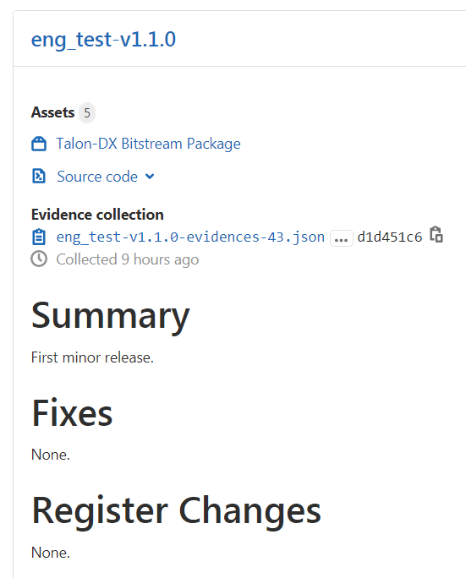
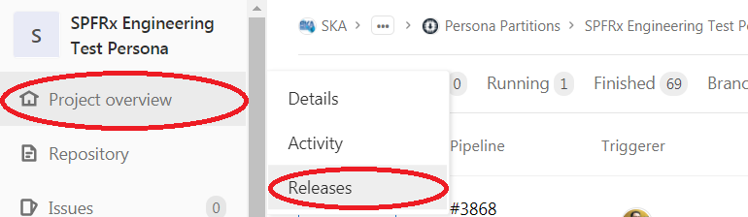
Gitlab Releases Page
You can edit the release note through the Gitlab interface later if necessary.

Slide 8
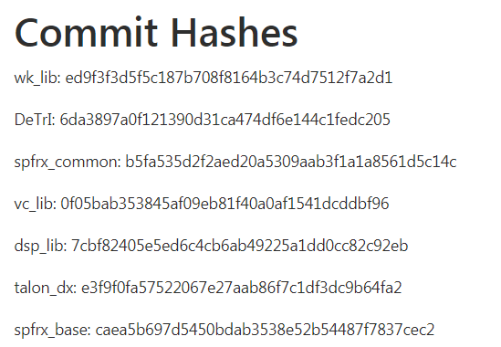
Traceability: Commit Hashes
Automatically collect commit hashes into release note.
A level of traceability in addition to tags.

Slide 9
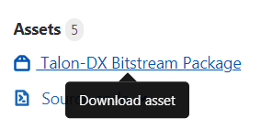
Release Artifacts
Asset package associated with a release contains:
  Everything software team needs to deploy on the Talon board.
  All FPGA synthesis, place and route reports.
Plan to start using in PI9.
  Expect process improvements based on user feedback.

Slide 10
Questions?
Stephen Harrison
Digital Systems Engineer
Tel: 250-497-2328
Stephen.Harrison@nrc-cnrc.gc.ca
www.nrc-cnrc.gc.ca
10

