Slide 1
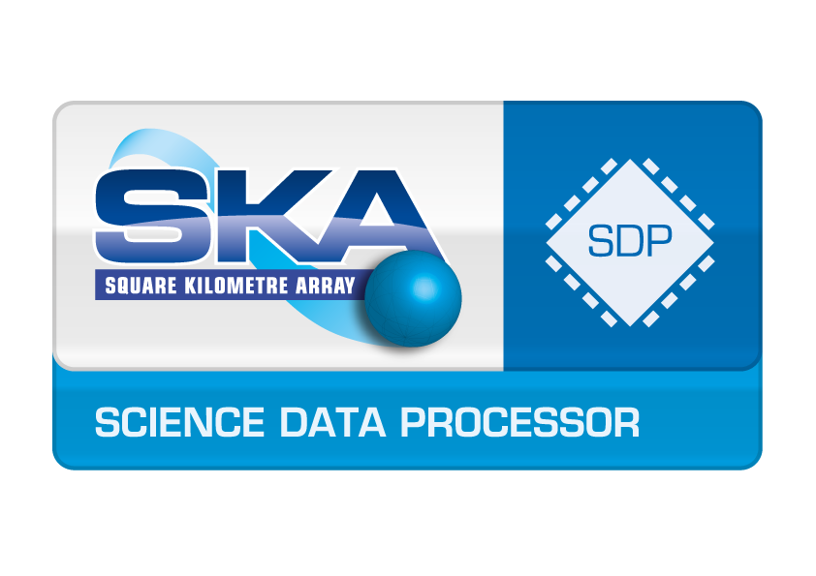

SP-511 Review of MSv3 Logical Data Model
System Demo #2
J.C. Guzman | YANDA Team
15 October 2019
ASTRONOMY AND SPACE SCIENCE

Slide 2
SP-511 Review MSv3 Logical Data Model
Goal: Review the latest MSv3 logical model documented in http://casacore.github.io/casacore-notes/264 and suggest modifications (if needed) based on latest version of the SKA Data Model.
Benefit Hypothesis:
  Making MSv3 compatible with SKA SDP Data Model needs as described in the CDR closeout documentation pack. Inform MSv3 development team of changes if there are gaps in the specification.
Acceptance Criteria:
  Report gaps between MSv3 data model and SKA SDP Data Model to the MSv3 development team in order to make MSv3 specification compatible with SKA needs (this presentation)

Slide 3
Documents Reviewed
Main Reference Documents
  Dijkema T.J., et.al., “MeasurementSet definition version 3.0Beta”, July 2019 http://casacore.github.io/casacore-notes/264#x1-230004
  Kirkham K., Wortmann P., “SDP System Data Model View”, SKA-TEL-SDP-0000013, Rev 07, 2019-03-15
Other Documents
  F.Viallefond, R. Lucas, “ALMA SDM Tables Short Description”, COMP-70.75.00.00-00?-A-DSN, March 19 2018.

Slide 4
Results
MSv3 defines a format in which inferferometer visibilities and single-dish data are stored. It contains all necessary data and meta-data from the telescope in order to perform calibration and imaging processing in batch processing (decoupled from the data acquisition system) – assume this is true for SKA
MSv3 logical data model follows same structure as MSv2 but it is not backwards compatible (a converter will need to be implemented)
  The subtable row numbers (e.g., in ANTENNA) are not used as implicit keys anymore. All keys are made explicit.
  Addition of a BEAM subtable to describe a BEAM per telescope, possible dependent on time.
  Addition of a PHASED_ARRAY to describe the positions of the elements in a phased array.
  Removal of redundant columns (WEIGHT_SPECTRUM and WEIGHT, FLAG and FLAG_ROW).
  Possibility to add several versions of DATA, WEIGHT and FLAG columns. This removes the need for the columns SIGMA, CORRECTED_DATA, MODEL_DATA

Slide 5
Map

Slide 6
Findings
MSv3 maps 1-to-1 to SDP Visibility Model it is based on MSv3 – to be used for raw and calibrated visibilities and single-dish data
MSv3 doc – missing table definition
  Calibration Tables – These are mentioned but not defined
  Array – how to support Sub-arrays (?) – It seems that the Array Table disappear but it is referenced from MAIN table
  QUALITY_* - Not sure what these are in detail
MSv3 contains several entities needed by the SDP Science Data Model: Telescope Configuration (incl. SB), Telescope State (coming from TMC/OSO)
MSv3 supports custom tables
MSv3 document difficult to navigate and issues
There is no MSv3 API implementation yet

Slide 7
Findings – cont.
If MSv3 is going to be a representation (or realization) of the SKA SDP Science Data Model, then
  Needs to contain Local Sky Model
  Needs to contain SDP Quality Metrics
  Needs to include Scheduling Blocks information – OBSERVATION table attributes are not sufficient
  Needs to include Processing Block information – New SKA specific table
  Processing Logs can use the HISTORY table (and/or Observation Log entry in the OBSERVATION table)
  Needs to define CAL_TABLES for SKA (not sure if this can be shared with other instruments) - this is probably needed even if MSv3 will not be = SKA SDM

Slide 8
Additional User Stories or new Features (for discussion)
Improve MSv3 definition document: add UML or equivalent diagrams to show relationship between entities and better navigation and also include missing tables or clarify (ARRAY, QUALITY_*) – Use IVOA docs as template/examples
Define CAL_TABLES for SKA
Decide whether to use MeasurementSet logical data model to also describe SKA Science Data Model, or evaluate ALMA Science Data Model to be used as the reference(format) SDM for SKA, or create our own format (to be discussed)
Check if combination of FEED + BEAM + PHASED_ARRAY tables covers Phased Array Feeds telescopes such as ASKAP and Apertif (beamweights/beam footprints seems to be missing)
After MSv3 logical data model is reviewed (and agreed by SKA, NRAO and others) -> API implementation in C++ and Python (likely in casacore)

Slide 9
CSIRO Astronomy and Space Science (CASS)
  J.C. Guzman
  SKA Bridging – Team YANDA
    t +61 8 64368569
    e juan.guzman@csiro.au
    w www.atnf.csiro.au
Astronomy and space science

