Slide 1
Design Baseline Description
P. Dewdney
2019-Mar-22

Slide 2
Readership and Stakeholders
Diverse readership and multi-purpose document:
  System CDR Panel,
    Guide to the Review.
  SKA Board members,
    Synopsis of what they are guiding
  Science community and potential science users,
    Introductory document on capabilities,
    Reference document.
  Development teams, operations and engineering staff,
    Reference document,
    Introduction to new hires.
  Informed agency persons,
    Persons in government departments.
  Potential organisations looking to join the SKA.
    Every hopeful – maybe inspire them to join.
Goal: help each stakeholder get what they need out of it.

Slide 3
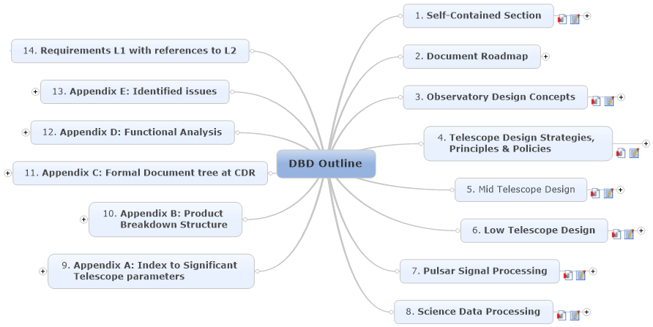
DBD Structure
Read clockwise.

Slide 4
Writing Guidelines
Describing the Design Baseline and the ‘Reference Designs’ (i.e., designs contained in the CDR documents).
Directed at approximately Level 2 and below in the mind-map.
Target length of ~5-10 pages text + diagrams + tables.
Intermediate level
  between detailed and overview.
Assume that the reader is familiar with but not an expert in a specific area.
  Plain language is the norm. Minimal jargon, not too many acronyms unless they are well known.
  Applies equally to hardware and software
Submitted text will be edited for style and conciseness.

Slide 5
Suggested Starting Point for Headings
These do not apply everywhere, but should be a useful check list.
How does it fit into the telescope system description?
  This need not be a stand-alone description and need not be long, since this topic will be covered in more depth in a system overview section.
  Likely part of a major sub-system (e.g. Dish structure).
  This part of the description may be extracted from this section and also used in a more general overview.
Design justification/motivation/choice (summary).
  Design philosophy.
  Functional description (diagrams may be needed, but not huge complex ones), including a cross-reference to the relevant product.
  A summary of possible choices that could have been made.
  Motivation for choice.
Diagrams illustrating concepts and key details.
  Context diagram.
  High level diagram.

Slide 6
Suggested Starting Point for Headings
Technical Description (How does it work?).
  Description of the sub-system that covers significant detail (not trivial detail).
  Other diagrams as needed.
Non-trivial inputs, outputs and controls (interfaces).
  Diagram showing these interfaces.
  Emphasis on any interfaces that have user/observer/operations aspects.
  Description of interface flows.
Tables of parameters of interest to users and observers.
  Consolidated lists of parameters that are either built into the system (and are design parameters); their names and values.
  Consolidated list of user-settable parameters, their names and values (default max, min, delta).
  The goal is to have this type of reference material in one place, and in the context of the design.

Slide 7
Suggested Starting Point for Headings
Performance characteristics.
  Description of key performance attributes (What does performance actually mean for this area?), such as timing, power consumption, temperature range, etc.
  Tables of performance parameters, where not already contained in item 6 above.
  In some cases, a few sentences on what it cannot do, if that is important.
  Affected error budget items.
References
  Primary references: references such as ADD, DDD, top-level science, etc.
  Secondary references: key details.
  Often there are only incomplete primary references. In those cases, a large number of secondary references may be needed.
Table of relevant requirements
  This will not be in line with the text, but will serve as a cross-check for gaps and issues. These tables may appear in an extended appendix or separate volume.

Slide 8
Diagrams
Scalable over a wide range, but definitely clear on an A4 portrait format (or at most on an A4 landscape format).
  Decide in advance which format is to be used and draw for that format.
Simplest possible display of concepts, designs or results.
  No unnecessary embellishment or decoration.
  Maximise content and clarity.
Drawn in Visio if possible
  SKA standard for a long time.
If possible, graphs should not depend on captions to be understood.
Axes on graphs labelled with large enough font to be readable when scaled to A4.
Maximum use of space but not over-crowded.
Maximise use of colours to convey clarity or content – otherwise colour not used.
Line thicknesses should always be defined and not left as default.
Text size should be scaled to utilise all the available space, at least to a size that is easily readable.
Limited use of ‘crossing paths’ in flow diagrams.
Standard SKA terminology only.
Special symbols (e.g. SysML) should be avoided unless necessary to convey the concept.
  In such cases the symbols should be explained on the diagram.

Slide 9
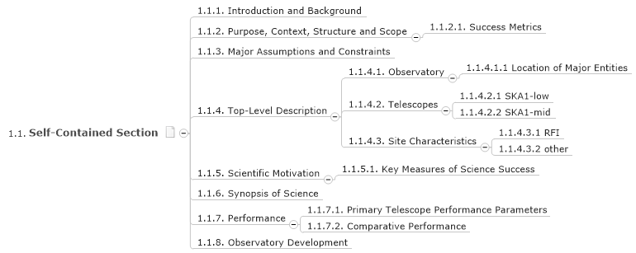

Self-Contained Section & Roadmap
This section is to be read by those looking for a short description of the entire SKA1 project.
The reader can also look at the document roadmap to select more detailed information.
Not many details are contained in this section, so cross referencing to other sections is essential

Slide 10
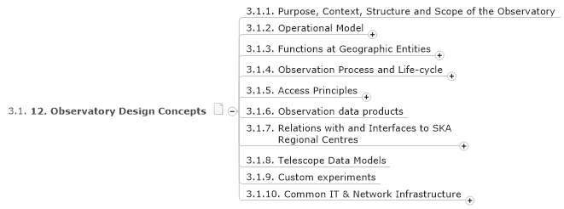
Observatory Design Concepts
This section descriptively lays out the purpose, structure, locations, and overall design of the Observatory.
  It is not a long section, but covers everything that an outside party would wish to know:
What is the SKA all about and how is it organised?
  what observations are possible (capabilities)?
  how does it carry out observations?
  who has access?

Slide 11
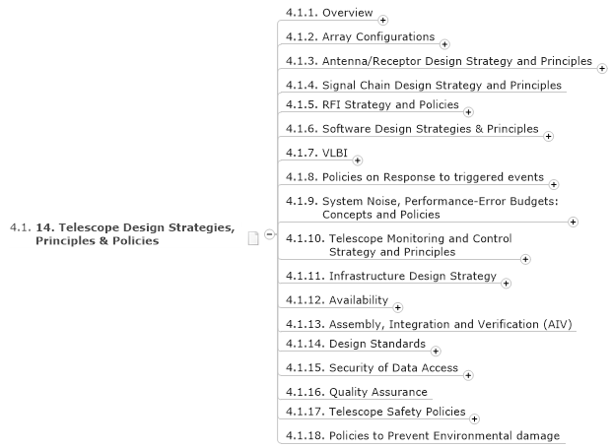
Telescope Design Concepts: The Why.
Design approaches, constraints, and goals across the systems
  how they fit in to the Observatory.
Emphasis on pan-system description, flows and linkages across the system.
Approach to error analysis, associated models/parameters, error budgets, calibration methods, calibration time-scales
  Actual budgets, calibration methods, models, etc explained in the individual telescope sections.
Approaches to Quality Assurance, Safety, Design Standards, Environmental impact, IT, Availability, Maintenance, AIV, Infrastructure

Slide 12
Mid Telescope Design: The What.
Different 'views' of the telescope system (physical, functional, performance, scientific capability, sky coverage, etc.).
Key Mid Parameters: a parameterised summary of the capabilities of the telescope (referenceable).
Architecture: diagrams showing the components, functions, and data/data-flows.
System Performance-Error Budgets (Mid-specific).
Major Components:
  End-to-end description of the telescope.
  Many sections
  Referenceable tables.
Also including:
  RFI Environment.
  Signal Chain.
  Infrastructure.
  Availability and Maintenance.
  Physical Environment.

Slide 13
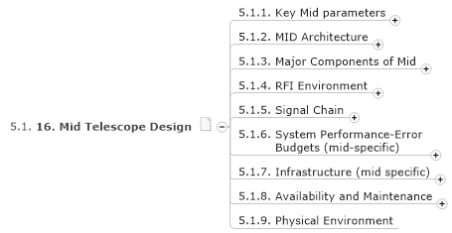
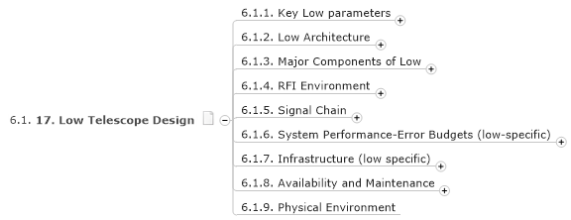
The Telescope Designs: The What.

Slide 14
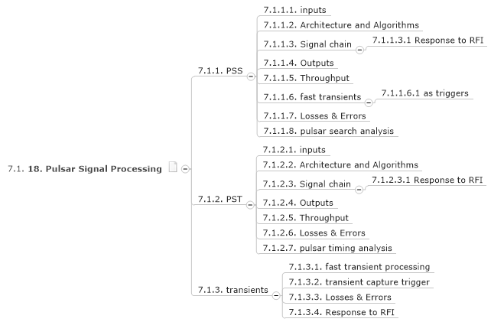
Pulsar Processing: The What.
Inputs: This describes the beam-formed inputs and their quality requirements, bandwidths, bit-widths, etc.
Architecture and Algorithms: This describes the algorithms selected (and briefly, the reasons). It also describes the overall architecture.
Signal Chain: A signal chain analysis similar to that for the CBFs.
  Response to RFI
Outputs: A summary of outputs and their contents (candidate pulsars or timing outputs).
  Includes analysis (previously in SDP).
Throughput: How much processing is possible, how many beams, etc.
Fast Transients:
  PSS is responsible for triggering the capture of voltage buffers in the CBF systems.

Slide 15
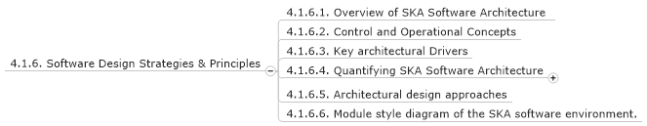
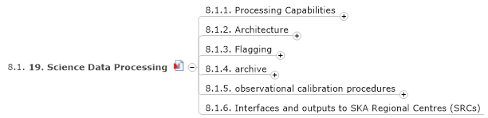
Science Data Processing
Note two trees – one is in the Strategies and Principles section and the other is in SDP stand-alone section.
Processing Capabilities: The usual types are covered, plus a special EoR/Cosmic Dawn which will need special attention.
Architecture: This describes the inputs from the CBFs, the system design, throughput, and outputs (data products).
  through-put - given a model of the expected usage of the telescope.
Flagging: This is called out for special attention, since it may a limiting factor in achieving telescope goals.
Archive (functions, architecture, performance).
Calibration: This section describes SDP's role in calibration telescope-independent terms as much as possible.
  The application of calibration to each telescope is described in the Mid-Telescope and Low-Telescope sections.

Slide 16
End

